Slide 1
Big Bang ASQ-2.0 (CSQE Test E-portal)
By-
Team Quality Coders
Neeleshwari Rajput
Srinivas Thungathurti
Ziyi Yan
Rajesh Nerkar

Slide 2
Contents
Project description
Scope
Big Bang ASQ-2.0
Requirement Estimation
Project Plan
Software methodology
Technology
Use cases
Test strategies
Test cases
Traceability matrix
References
Appendix

Slide 3
Project Description
Web application that simulates the ASQ CSQE Exam.
It allows the test taker to give sample test and track their records.
It help users in practicing for the test and improve their performance by comparing their 10 previous scores.
It will provide sample questions given by ASQ.
Same test format and time constraints.

Slide 4
Scope
It is a web based service which helps a CSQE test taker to practice sample tests.
It provides a platform to the potential test taker to practice for the test and perform better in the official test, as it keeps the track of improvement of the test taker.
The service is accessible to any user after being enrolled in the system.

Slide 5
Big Bang ASQ-2.0
The existing web application, Big Bang ASQ, is upgraded in this version i.e. Big Bang ASQ-2.0.
Various functionality is been added to the existing project.
Basic project has been enhanced by addition of functions (requirements) such as;
addition of more fields to user registration screen,
sending confirmation email to user after successful registration,
check for valid subscription each time user logs in,
questions can be added/deleted/edited anytime admin wants,
addition of dynamic chart information for each exam record. And many more

Slide 6
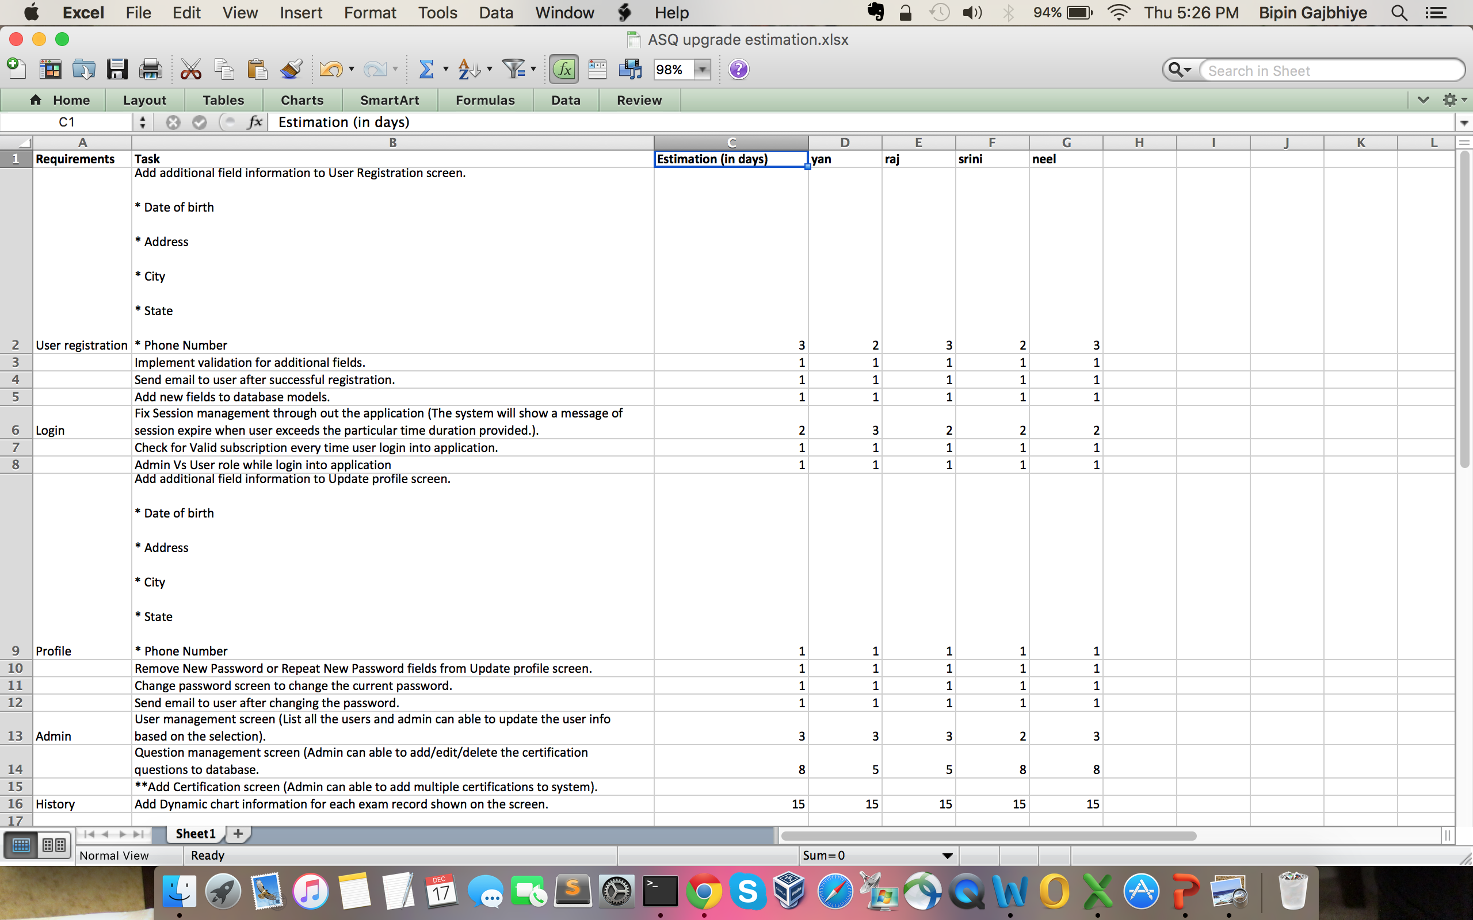
Requirements Estimation

Slide 7
Project plan

Slide 8
Software methodology
Agile scrum is used in following way-
Sprint planning (each sprint is 2 weeks long)
Daily stand-ups
Sprint review
Retrospectives

Slide 9
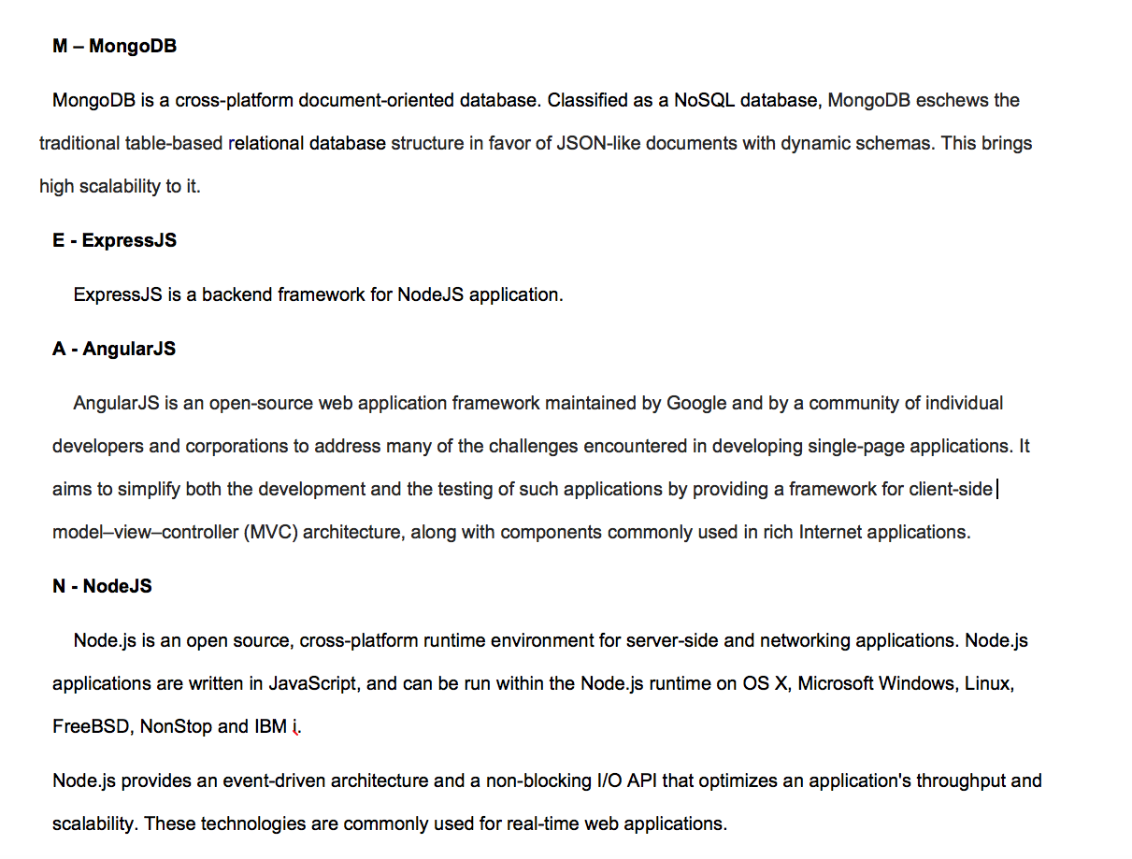

Technology

Slide 10
Use cases
To capture software requirements we have USE case document
The USE case captures the actor for the application
User
Admin
Use case also provides
Description of the requirement
Precondition and post-condition from actor’s perspective
Normal Flow in the application
Exceptions

Slide 11
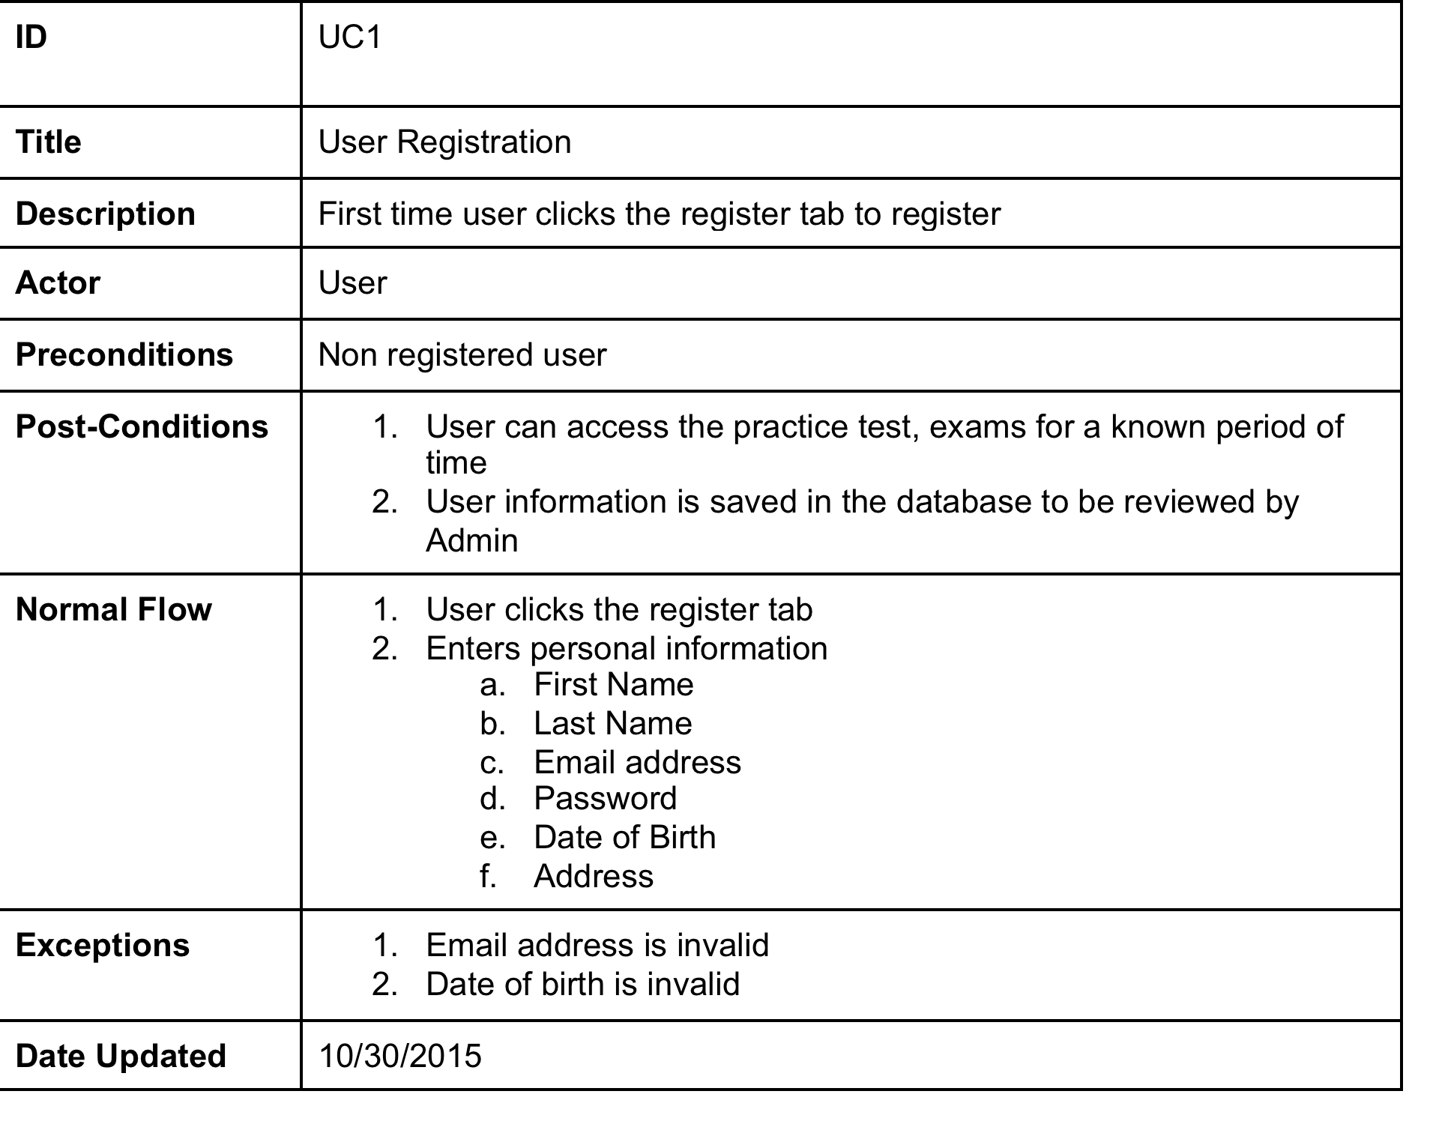
Use Case

Slide 12
Test strategies
Project is tested using Manual Testing
Black Box Testing technique is used for the testing
All the test cases are derived from the project requirement
The test cases cover testing for
Specification
Functionality
For bug reporting we used github

Slide 13
Test Case
Test-CaseID | TCID-R9 | Bug-Dec-14 | Update/Dec-18
Purpose | Database Update | N/A
Pre-Condition | Admin logged in | N/A
Step | Admin clicks Question mamagement
Result | Admin can update and add questions to the database | Add question feature was not working, screen use to force | Code updated to implement the feature
Test Platform | Safari, Chrome and Firefox
Date | Dec-14-2015
Test Result | Pass

Slide 14
Traceability Matrix
To track the test coverage for the requirements in the project we use Traceability Matrix
Traceability Matrix correlates test cases with the requirement of the project
Traceability Matrix requires
Functional Requirement ID
Test Case ID

Slide 15
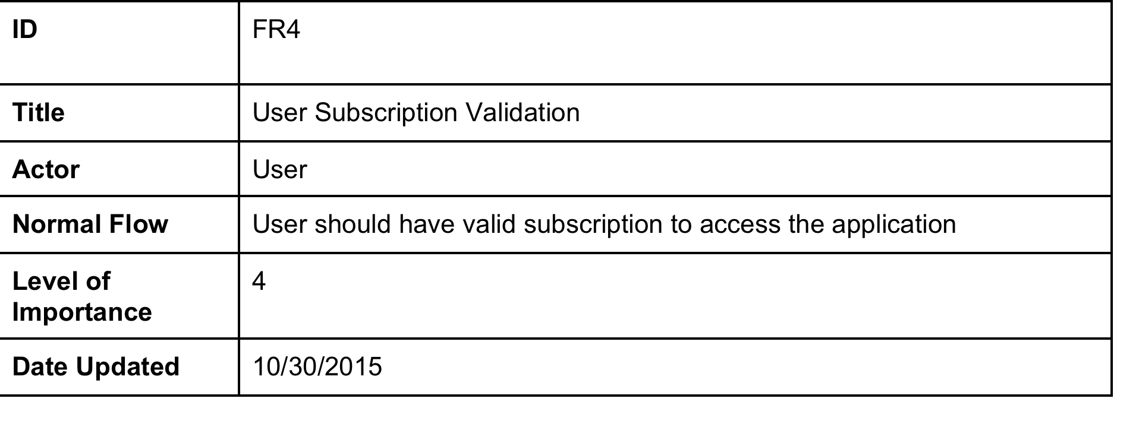
Functional Requirement

Slide 16
Traceability Matrix
Requirements |  | FR1 | FR2 | FR3 | FR4 | FR5 | FR6 | FR7 | FR8 | FR9 | FR10 | FR11 | FR12 | FR13 | FR14 | FR15 | FR16 | FR17
Test Cases | Coverage
TCID-R1 | 2 | x | x
TCID-R2 | 1 |  |  |  |  |  |  | x
TCID-R3 | 2 |  |  |  |  |  |  |  | x | x
TCID-R4 | 1 |  |  | x
TCID-R5 | 1 |  |  |  |  |  |  |  |  |  | x
TCID-R6 | 1 |  |  |  |  |  |  |  |  |  |  | x
TCID-R7 | 1 |  |  |  |  |  |  |  |  |  |  |  | x
TCID-R8 | 3 |  |  |  | x |  |  |  |  |  |  |  |  | x | x
TCID-R9 | 2 |  |  |  |  |  |  |  |  |  |  |  |  |  |  | x | x
TCID-R10 | 1 |  |  |  |  |  |  |  |  |  |  |  |  |  |  |  |  | x
TCID-R11 | 2 |  |  |  |  | x | x
Total | 17

Slide 17
Appendix

Slide 18
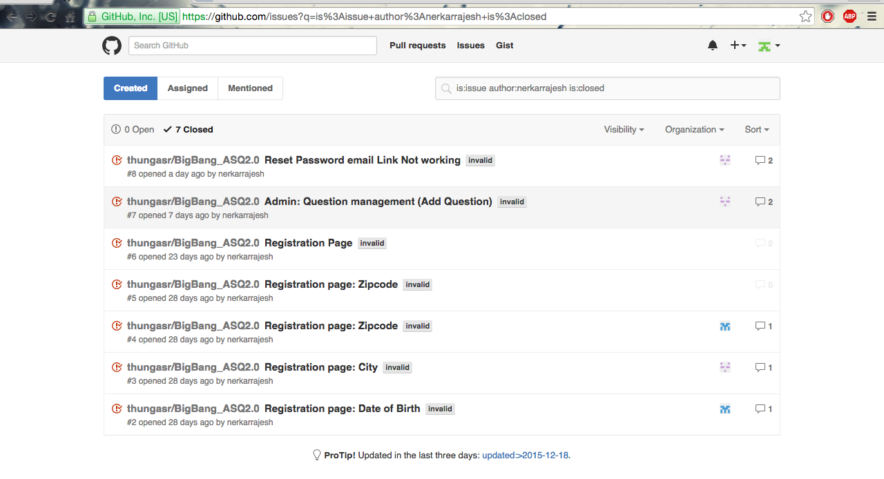
Github

Slide 19
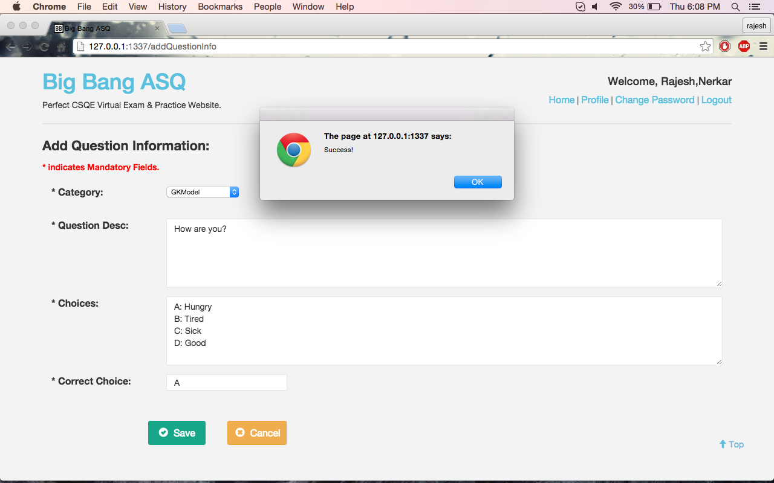
Highlights

Slide 20
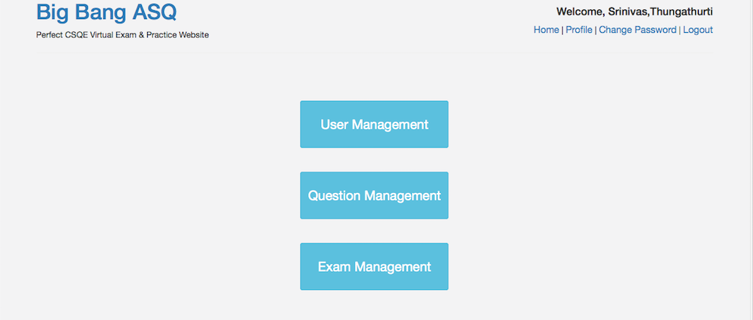

Slide 21
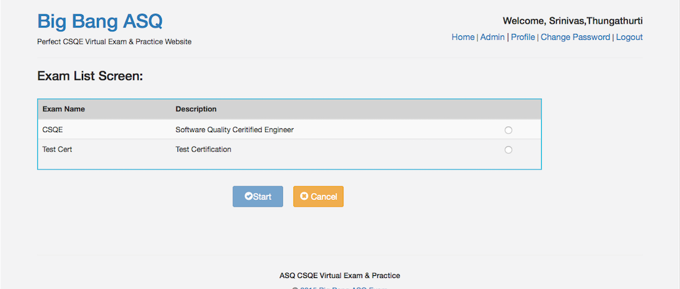

Slide 22
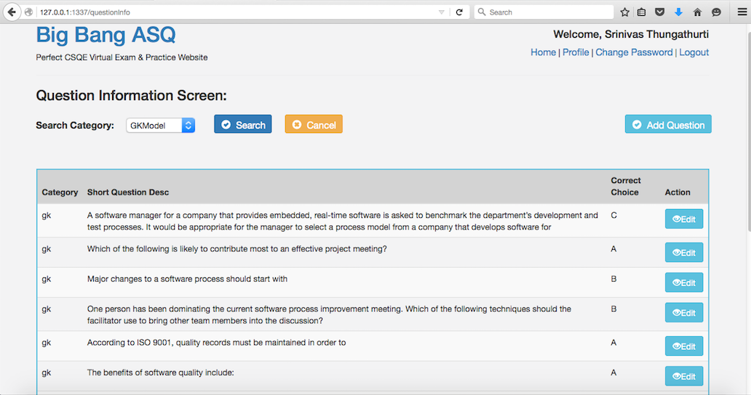

Slide 23
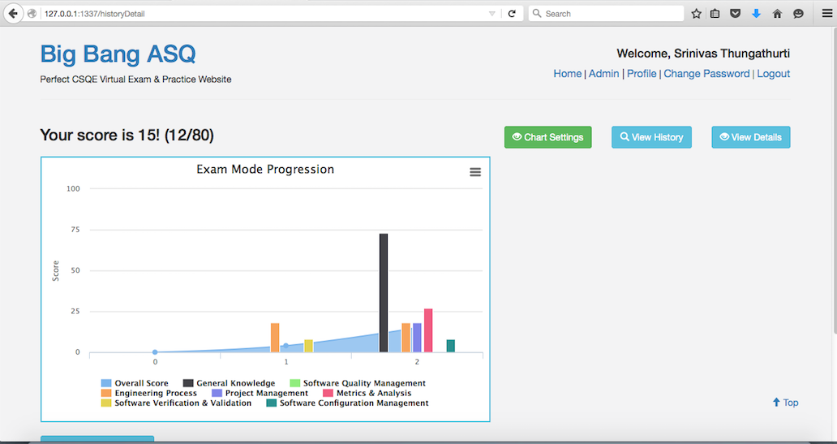

Slide 24
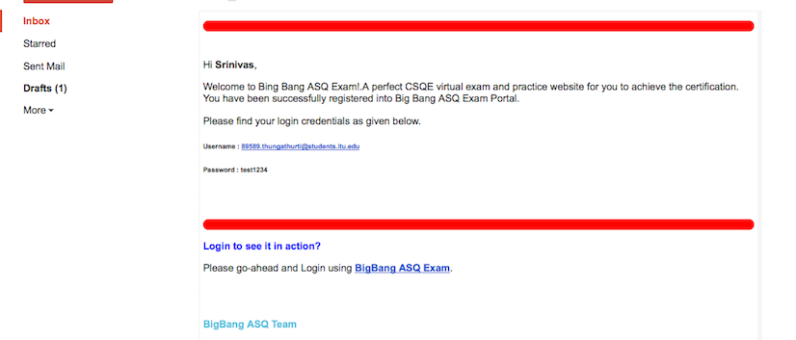

Slide 25
References
For information about ITU, visit: http://itu.edu
For information about ASQ, visit: http://asq.org/index.aspx
For information about the Quality Council of Indiana, visit: http://www.qualitycouncil.com
For information about MEAN Framework, visit http://mean.io/#!/
For the unit testing visit: http://unitjs.com/guide/mocha.html
For project code on github visit: https://github.com/thungasr/BigBang_ASQ2.0

Slide 26
Thank You

